Slide 1
Open PhD 2026 Presentazione dottorati di ricerca a.a. 2026/27 Dottorato di ricerca in Medicina Molecolare
Udine, 29 APRILE 2026
Direzione RICERCA, BIBLIOTECHE E TERZA MISSIONE

Slide 2
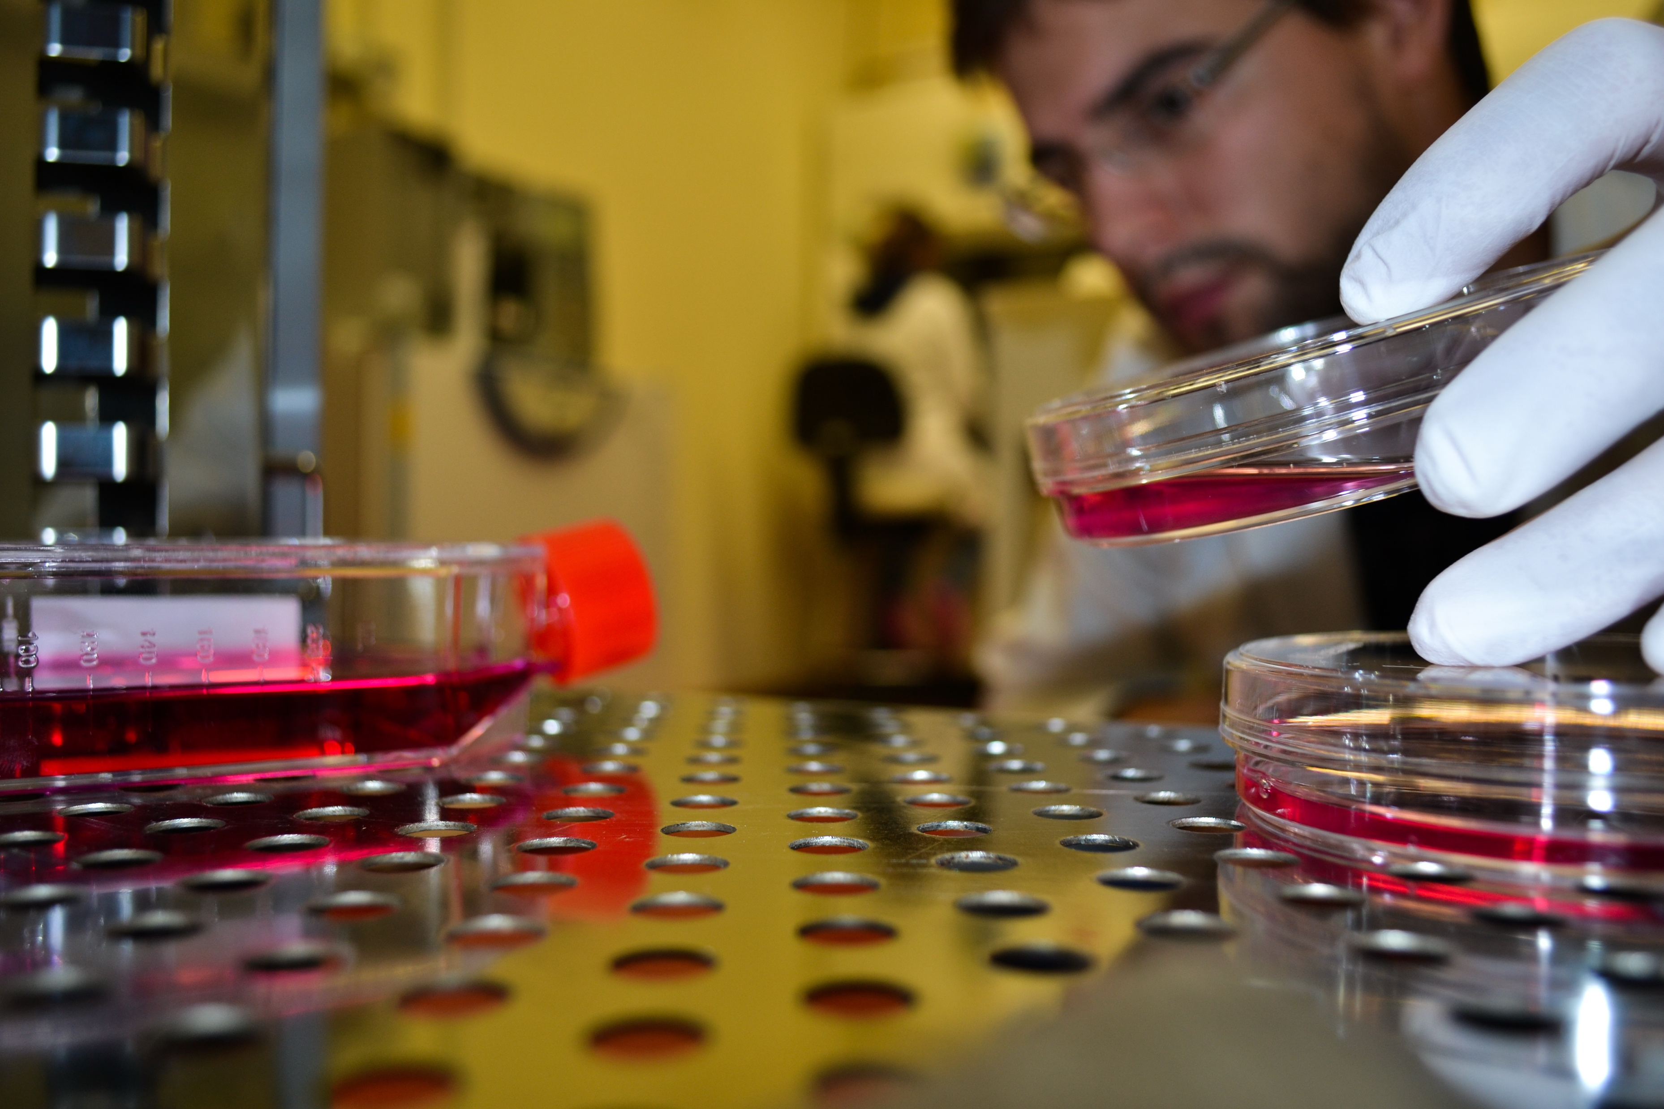
A 3-year, full-time doctoral programme combining basic and clinical biomedical sciences.
Multidisciplinary and translational approach to major human diseases.
- Open to talented student from all over the world.

Slide 3
Research Areas
Our PhD covers four main research tracks:
1. Cancer: From molecular oncology to new therapies.
2. Immunity and Inflammation.
3. Molecular Mechanisms of Cellular Ageing & Therapeutic Perspectives.
4. Molecular Pathogenesis of Protein Misfolding Diseases.

Slide 4


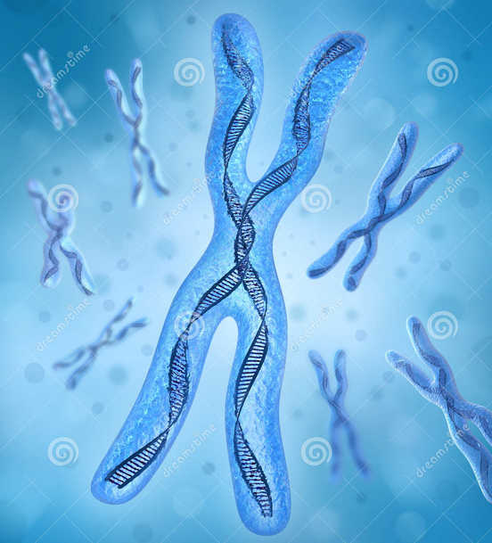
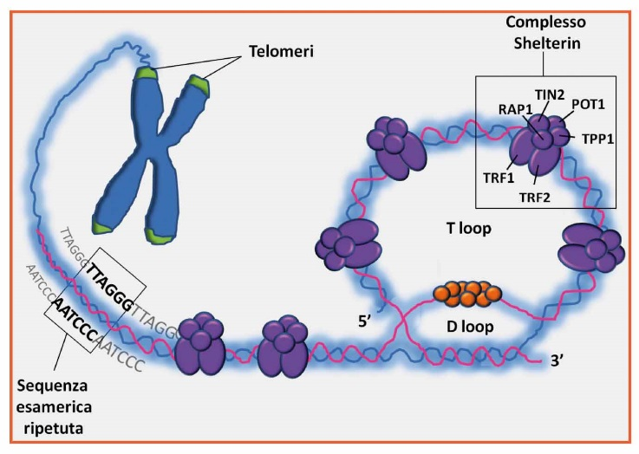
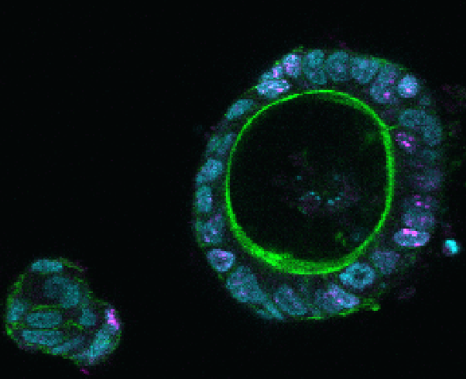
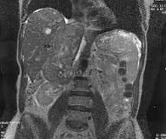
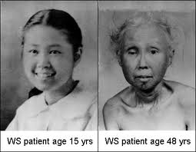
CANCER: FROM MOLECULAR ONCOLOGY TO INNOVATIVE THERAPIES
Epigenomic Lab
Laboratory of Molecular Biology and DNA repair
Patient-derived
organoids
Primary tissues
and cell models
Epigenetic
Analysis
Bio
informatics
Drug
Discovery
Genome
Editing
Genome repair pathways and non coding RNA functions
Colorectal Cancer
Leiomyosarcoma
CRO AVIANO IRCCS (RESEARCH HOSPITAL)
Oncogenetics and functional oncogenomics unit
Genetic-molecular mechanisms of cancer pathogenesis (epithelioid sarcoma, juvenile form, rare and aggressive)
- Alterations at the genetic, genomic, transcriptomic and epigenomic levels
New targets for molecular therapies towards personalised medicine.
in human cells relevant in aging

Slide 5
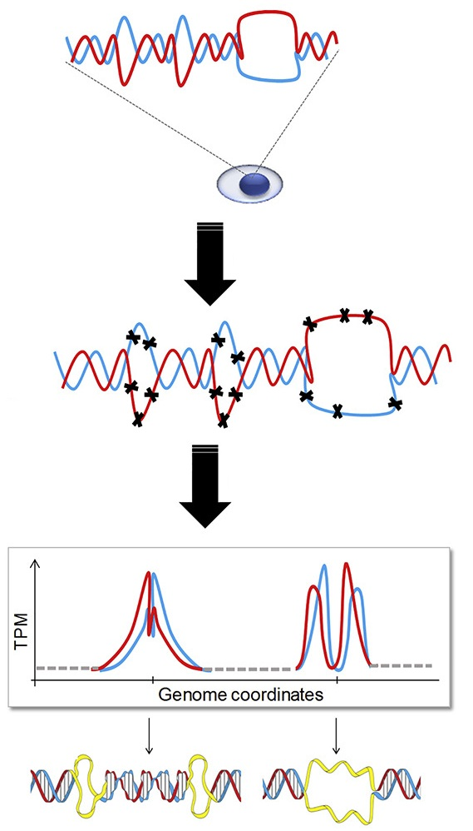
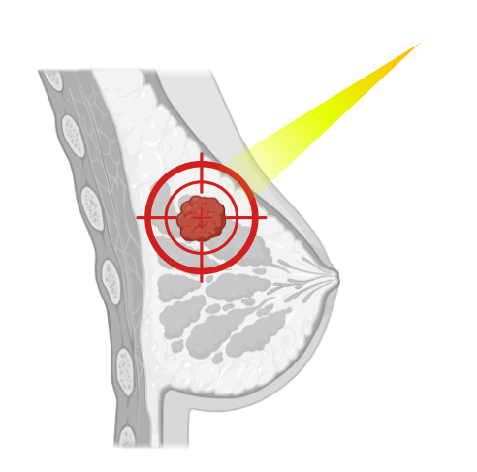
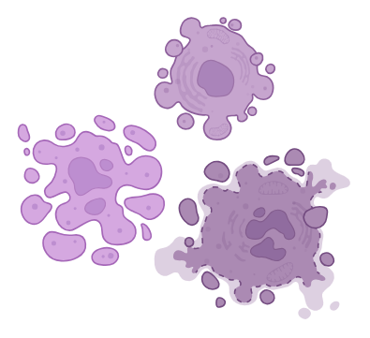



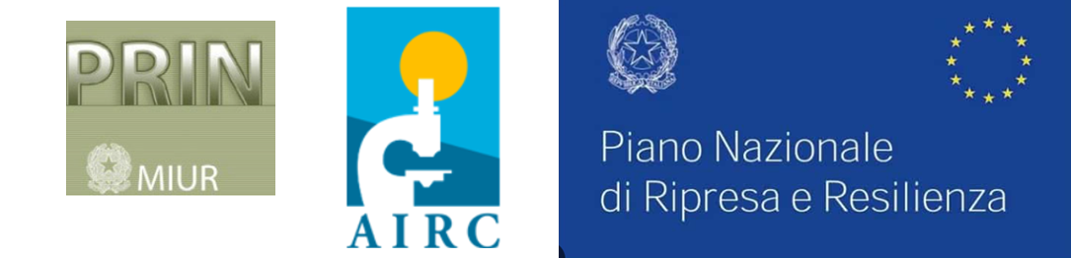
CANCER: FROM MOLECULAR ONCOLOGY
TO INNOVATIVE THERAPIES
Laboratory of Biochemistry
Research Projects
2. Study of non-B DNA structures in physiological and pathological states
Study of Nitric Oxide conjugate photoactivatable compounds for:
simultaneous oxidative stress-triggered cellular imaging
and photodynamic therapy to fight Triple negative breast cancer
PhotoActivatable no-photodonor
cancer cell death

Slide 6
CANCER: FROM MOLECULAR ONCOLOGY TO INNOVATIVE THERAPIES
Pathological Anatomy Lab
Brest cancer / High grade gliomas
Genetic/transcriptional profile
immune response
extra-cellular vescicles: properties (lipid, protein, RNA,..)
Platelet features
histopathological data
clinical data
AI
algorithm support clinical decision

Slide 7
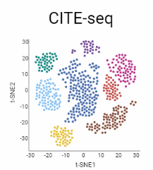
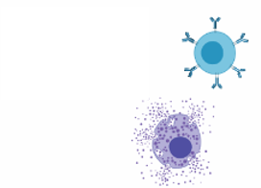
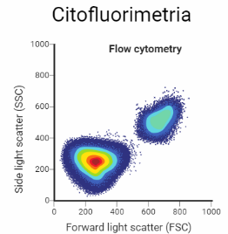
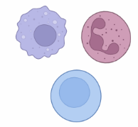
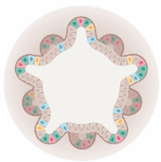
IMMUNITY AND INFLAMMATION
Immunology Lab
Lab of Rheumatology
Clinics
Study of lymphoproliferation in autoimmune diseases, from non-neoplastic forms to lymphoma, biomarkers, imaging and innovative therapies [Sjögren's syndrome, cryoglobulinaemic vasculitis, rheumatoid arthritis]
Epidemiology of systemic autoimmune diseases, quality of life and remote monitoring [Chronic arthritis, systemic vasculitis, systemic connective tissue diseases]
Predictors of chronic arthritis development [psoriatic arthritis]
Translational
Sjögren's syndrome: development of salivary gland organoids as a pre-clinical ex vivo model for new therapies and regenerative medicine
Chronic arthritis: study of chronic synovitis through molecular biology analysis of synovial biopsies
analysis of the tumour microenvironment and modulation of the immune response
study of the role of mast cells and B cells in intestinal diseases
Analysis of immune system cells
Organoid generation for data evaluation
Co-culture of organoids and immune system cells

Slide 8
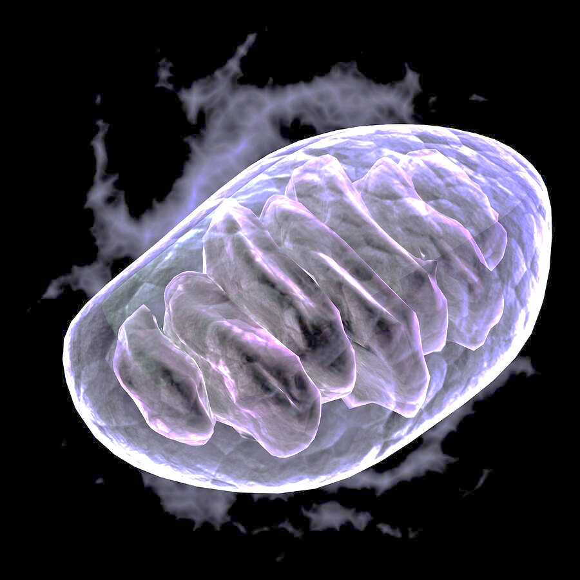
MOLECULAR MECHANISMS OF CELLULAR AGEING AND THERAPEUTIC PROSPECTS
Laboratory of Bioenergetics
Laboratory of Clinical Pathology
Research Projects
F-ATPase transformation into the PTP: the role of CyPD
Cellular and molecular mechanisms in the pathophysiology of diseases associated with genetic defects of F-ATPase
Targeting mitochondria as a therapeutic strategy in neuromuscular and cardiovascular diseases
Study human hearts cells with multi-lineage differentiation potential and stem cell features (pericytes/mural cells).
Investigate how cardiac pathology alters these cells and understand heart failure pathophysiology.
Employ various techniques (cell biology, transcriptomics, histology, confocal microscopy) and analyse clinical data to enhance understanding of this complex phenotype.
Experimenthal approaches:
Targeted genetic modification of cell lines, functional assays and high resolution images analyses of primary and cultured cells and of tissue biopsies
Production of recombinant proteins and protein/protein interaction analyses
Mitochondria transplantation
Multiomics approaches in different genetic models

Slide 9
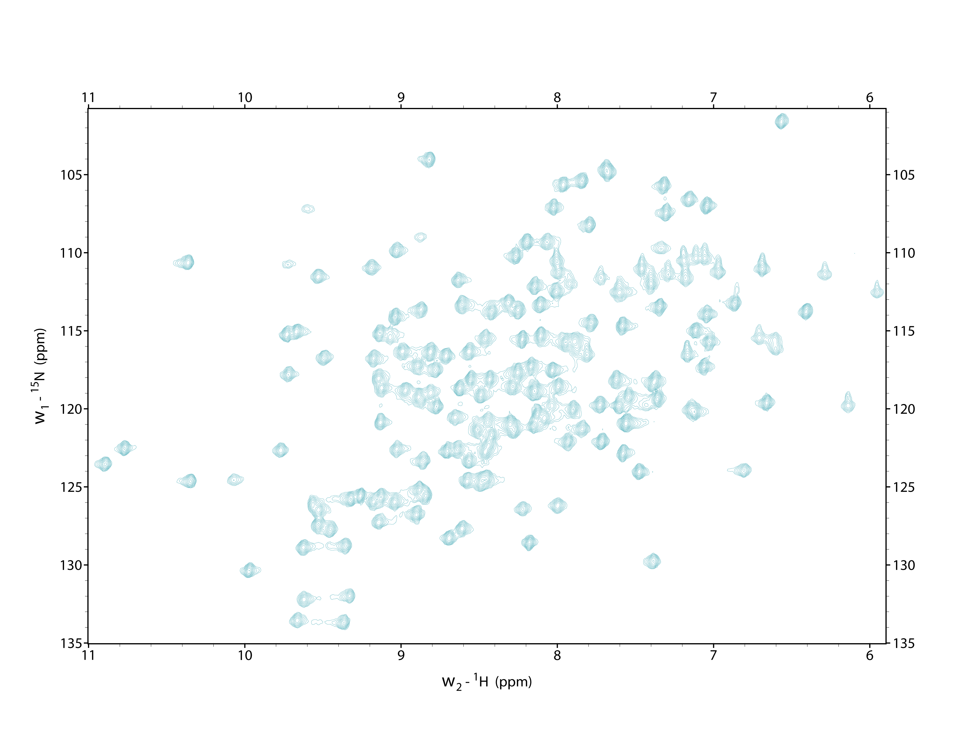
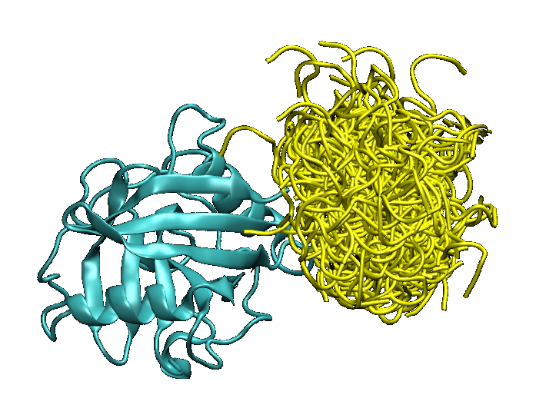
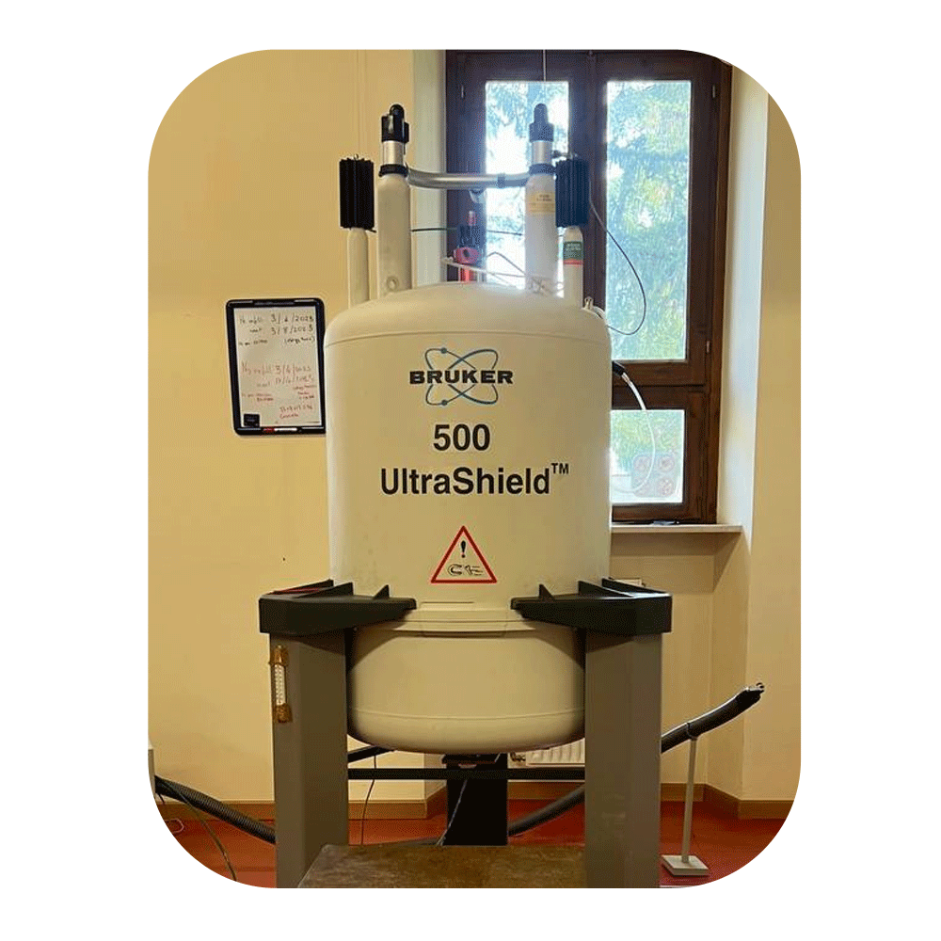
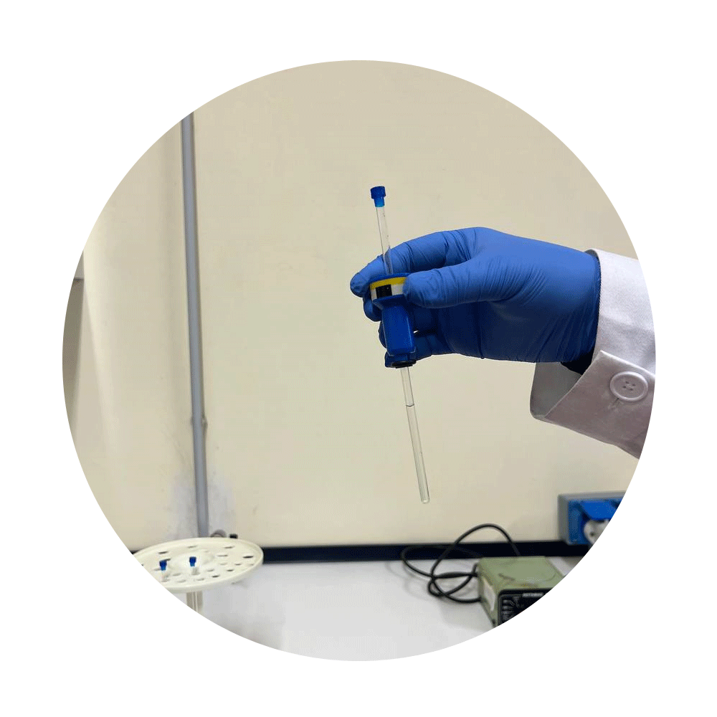


MOLECULAR PATHOGENESIS OF PROTEIN MISFOLDING DISEASES
Laboratory of Biophysics
RESEARCH AREAS
AMYLOIDOSIS
MITOCHONDRIAL BIOLOGY
Protein Dynamics
Structure Determination
Molecular Interactions
Effects of Mutations

Slide 10

TRAINING PROJECT
PhD training project:
development, under the guidance of the Supervisor, of an individual research program referring to a specific disciplinary field among those on which the Course is focused.
The individual research programme concludes with the writing of the thesis. The thesis, written in English, must contribute to the advancement of knowledge or methodology in the chosen field of investigation.
attendance of doctoral-level teaching activities complementary to the research.

Slide 11

TRAINING PROJECT
Multidisciplinary training
from biochemistry, biophysics and molecular biology to clinical translation, using state-of-the-art techniques
confocal microscopy, FACS, metabolomics, mass spectrometry, MALDI Imaging, biostatistics, bioinformatics, NMR, ...

Slide 12
Mobility
Opportunities:
Participation in European research networks.
Summer schools and advanced workshops.
Access to cutting-edge laboratories and collaborations abroad.

Slide 13
Join Us!
Annual calls in late spring and autumn
How to Apply:
Submit CV, two recommendation letters, and a short research proposal.
Oral examination for shortlisted candidates.
Annual intake: 6–10 students.
We Offer:
Excellent supervision and international exposure.
A vibrant, supportive scientific community.
A springboard to academic or industry careers in molecular medicine.
🌐 More info: www.uniud.it/en/research/do-research/doctorate-res?set_language=en
📧 Contact: alessandra.corazza@uniud.it

Slide 14
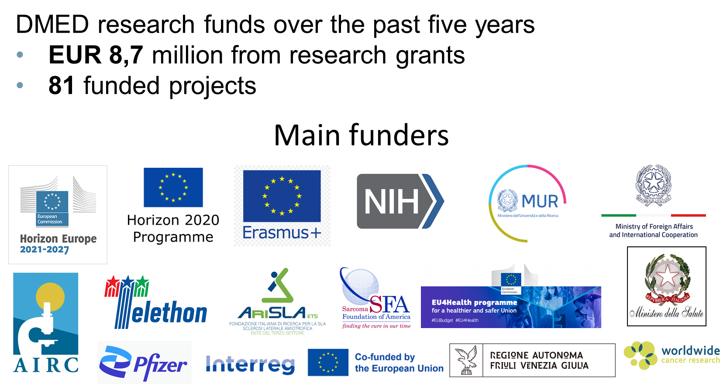

Slide 15
🧬 Shape the future of Molecular Medicine at the University of Udine!

Slide 16
Coordinatore: Alessandra Corazza alessandra.corazza@uniud.it Sito web del corso: https://www.uniud.it/it/ricerca/lavorare-nella-ricerca/dottorato-ricerca/i-nostri-corsi/area-life-science/medicina-molecolare/il-dottorato/medicina-molecolare-ex-biomed-tech
Udine, 29 APRILE 2026
Direzione RICERCA, BIBLIOTECHE E TERZA MISSIONE

Slide 17
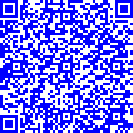
Il bando per l’ammissione al corso di dottorato è disponibile al sito:
Per ulteriori informazioni sulle procedure di ammissione contattare
Direzione ricerca, biblioteche e terza missione - Ufficio formazione per la ricerca
dottorato.rice@uniud.it
Udine, 29 APRILE 2026
Direzione RICERCA, BIBLIOTECHE E TERZA MISSIONE

