Slide 1
Open PhD 2026
Presentazione dottorati di ricerca a.a. 2026/27
Dottorato di ricerca in Scienze degli Alimenti
Udine, 29 APRILE 2026
Direzione RICERCA, BIBLIOTECHE E TERZA MISSIONE

Slide 2


PhD Course in Food Science
The Doctorate represents the highest level of education for the training
of researchers who will work
- at university
- in public institutions
- in private entities
Admission to the PhD course requires the successful completion of the entrance exam
with a research project that will be developed within 3 years
Scholarships will be funded by
the University, public institutions, companies or specific programs

Slide 3
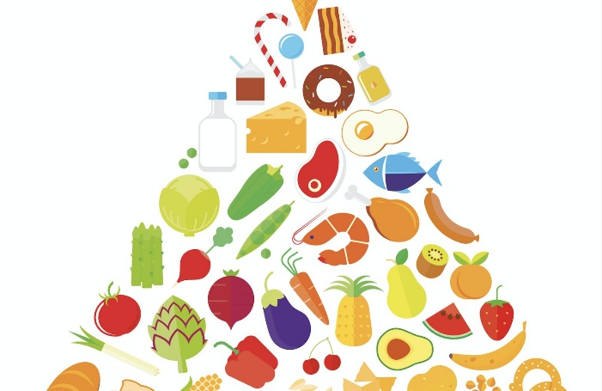

Objectives of the PhD course
Build a profile of researchers in the food science and technology area for
- research in academia
- research and development in the industry
This professional figure will acquire interdisciplinary skills that allow the researcher to solve issues concerning food design, production, conservation, processing, consumption and food safety with positive effects on health and the environment
Food Safety

Slide 4
Doctoral path
The training of doctoral students includes a solid research curriculum that favors
a critical thinking and freedom to carry out research
Experimental activity
in laboratories under the constant guidance of a supervisor
6 -12 months period of study and research abroad or in a company
presentation / publication of the results of the research
Education activity
complementary courses (soft skills) and specific courses
A significant part of the activities are carried out in English: seminars, courses, presentations
The thesis will be written and discussed in English

Slide 5
PhD research topics
1) Food safety, quality traceability and shelf-life
2) Improvement of the nutritional functionality of ingredients and foods
Microbial fermentations for food and beverages
4) Use of waste from the agri-food chain
These issues are consistent with a Sustainable Development

Slide 6
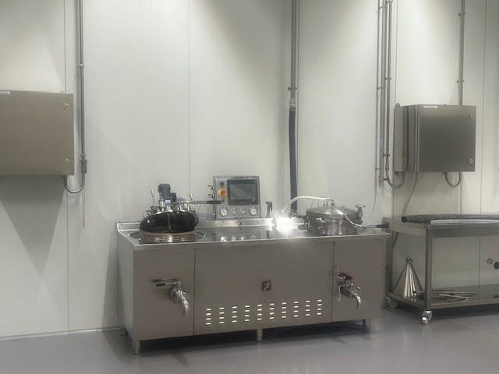
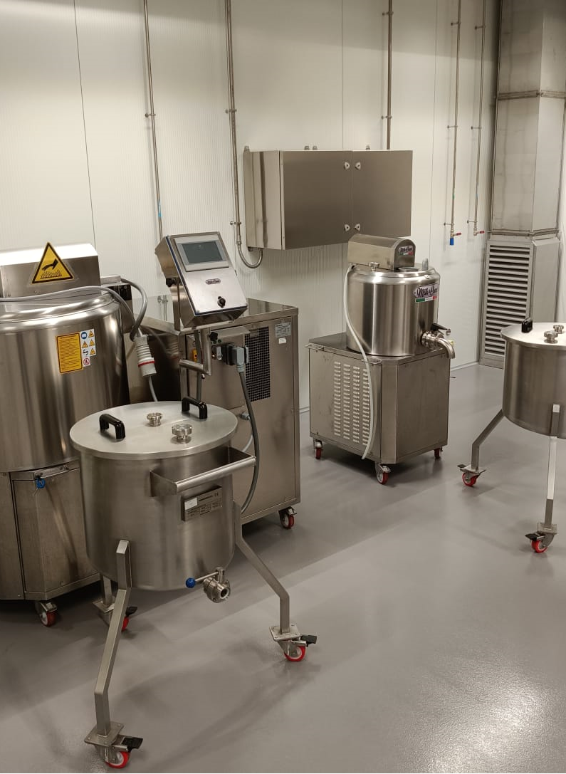
Food technology
Development of new ingredients and foods from bio-resources
Strategies for the conversion of by-products of the food industry into resources
Study of the relationships between food processing and human health
Strategies to create foods that meet specific nutritional and health needs and the effect of technological strategies on nutrients and bioactive compounds
Extension and prediction of the shelf life of food
Development of protocols for the determination and prediction of the primary and secondary shelf life of packaged foods

Slide 7
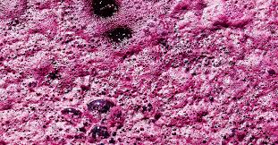
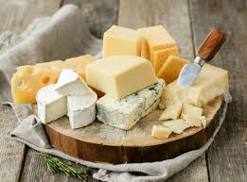

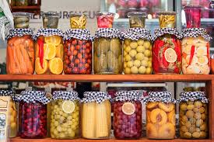
  Circular food & wine production and waste reduction
  Understanding microbial interaction in food and wine fermentations for bioprotection
  Microorganisms as bioresources for
  a) isolation of microbial starters for bioprotection for sustainable food
  b) conversion of by-products of food and wine industry using microbial activity to promote the circular economy

Slide 8
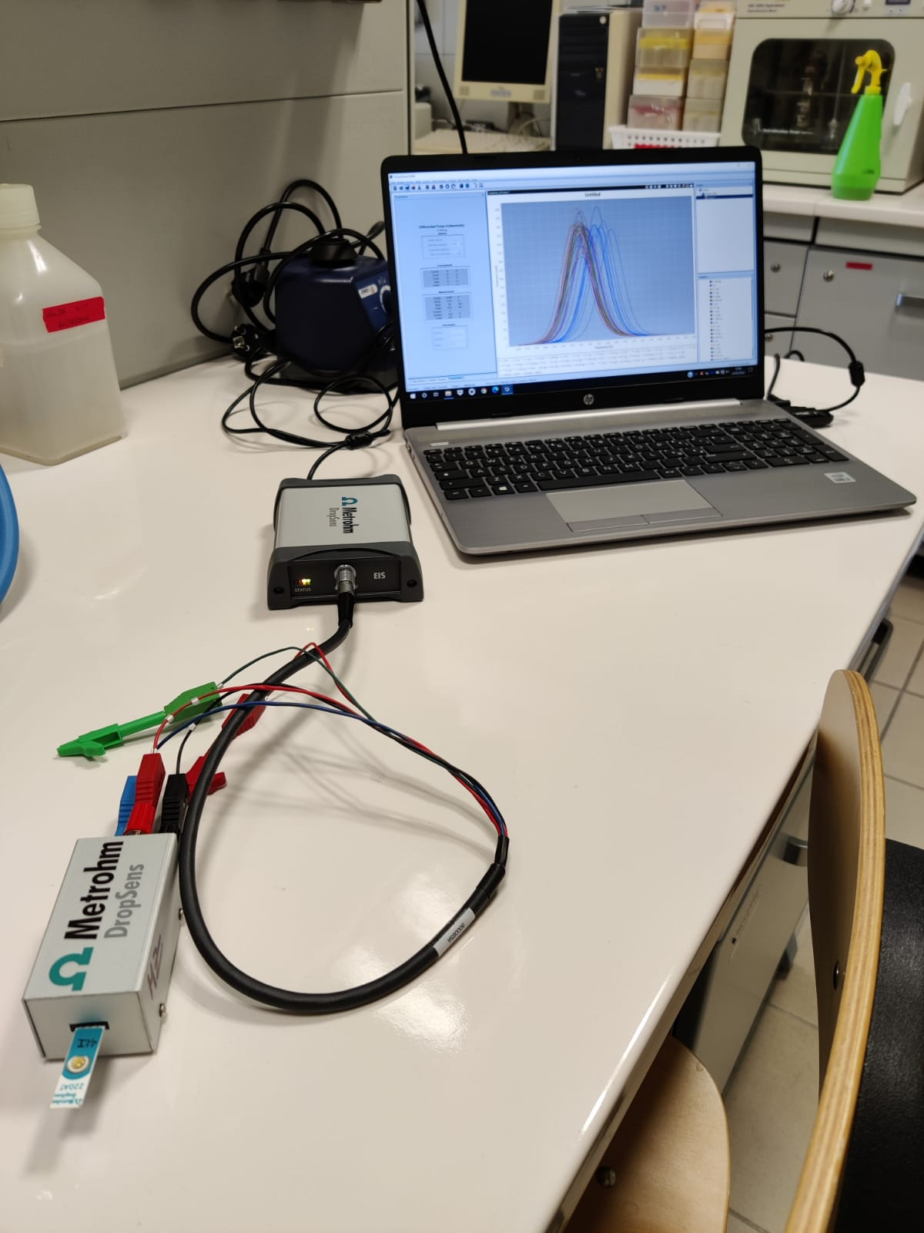
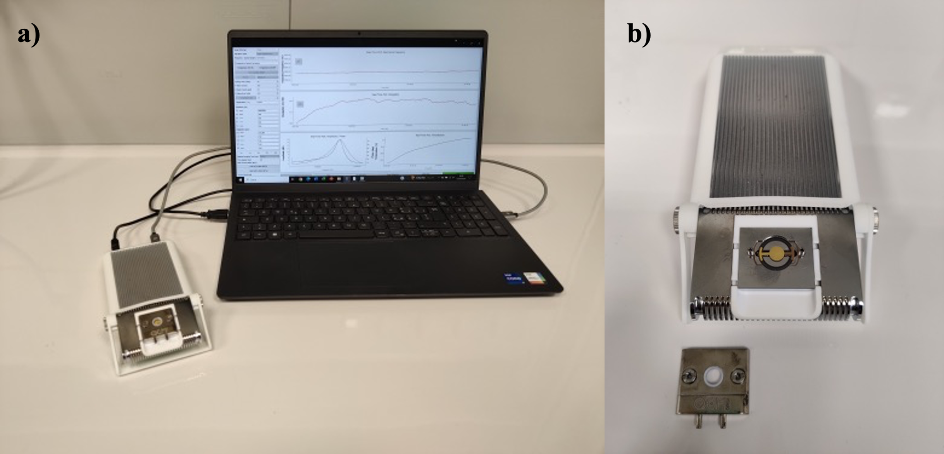
DEVELOPMENT OF BIOSENSORS FOR FOOD QUALITY
Electrochemical biosensor
for the detection of Campylobacter jejuni in
meat samples
Surface Plasmon Resonance (SPR) sensor and
Quartz Crystal Microbalance (QCM) sensor for
the detection of Escherichia coli cells in water

Slide 9
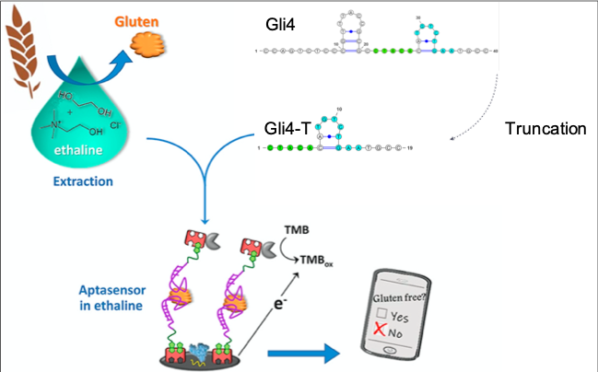
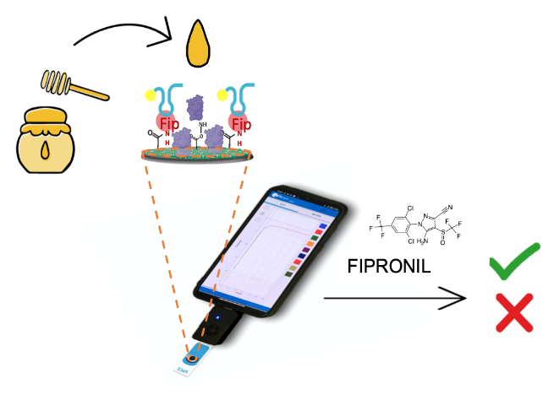
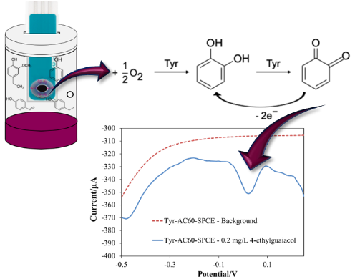
Development of green sensors
Fipronil
Glutine
Gas sensors with electrolytes and biodegradable materials
Biosensors for the analysis of allergens and pesticides
USE OF PROBES AND APTAMERS FOR THE DETECTION OF
SPECIFIC CELLULAR AND DNA TARGETS

Slide 10
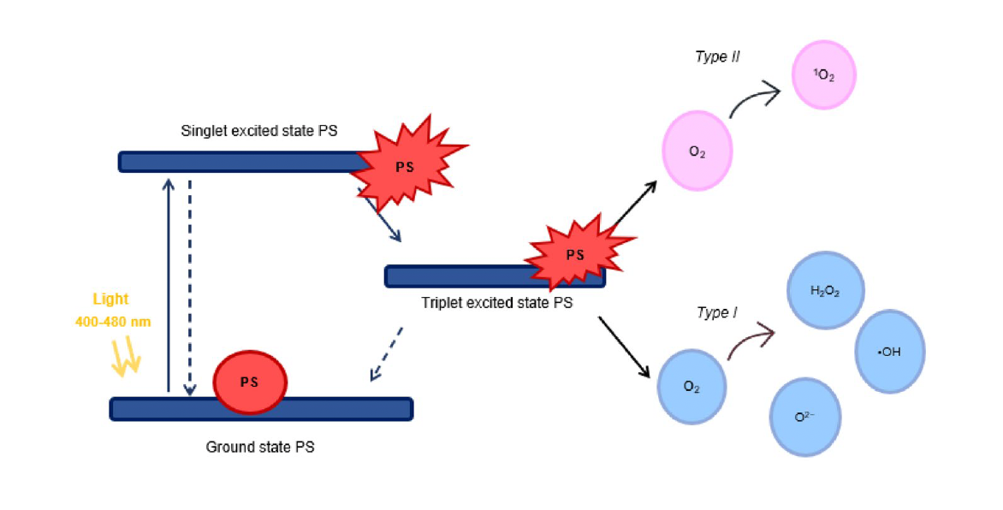
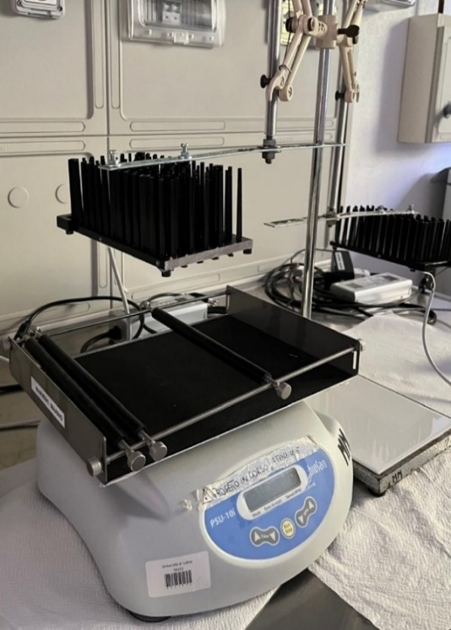
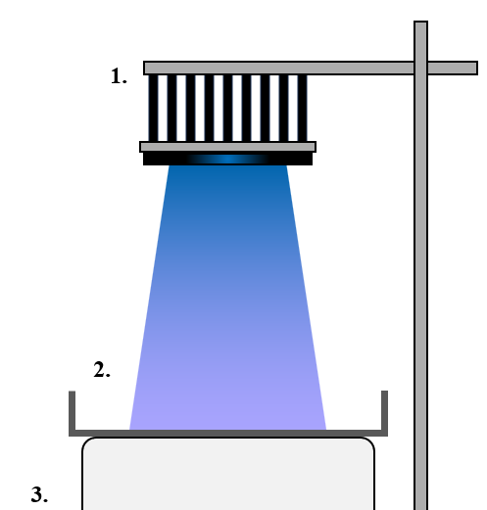
APPLICATION OF BLUE LIGHT-EMITTING DIODES FOR MICROBIAL INACTIVATION
Blue light is an emerging technology used for the decontamination of surfaces and products in contact with food

Slide 11
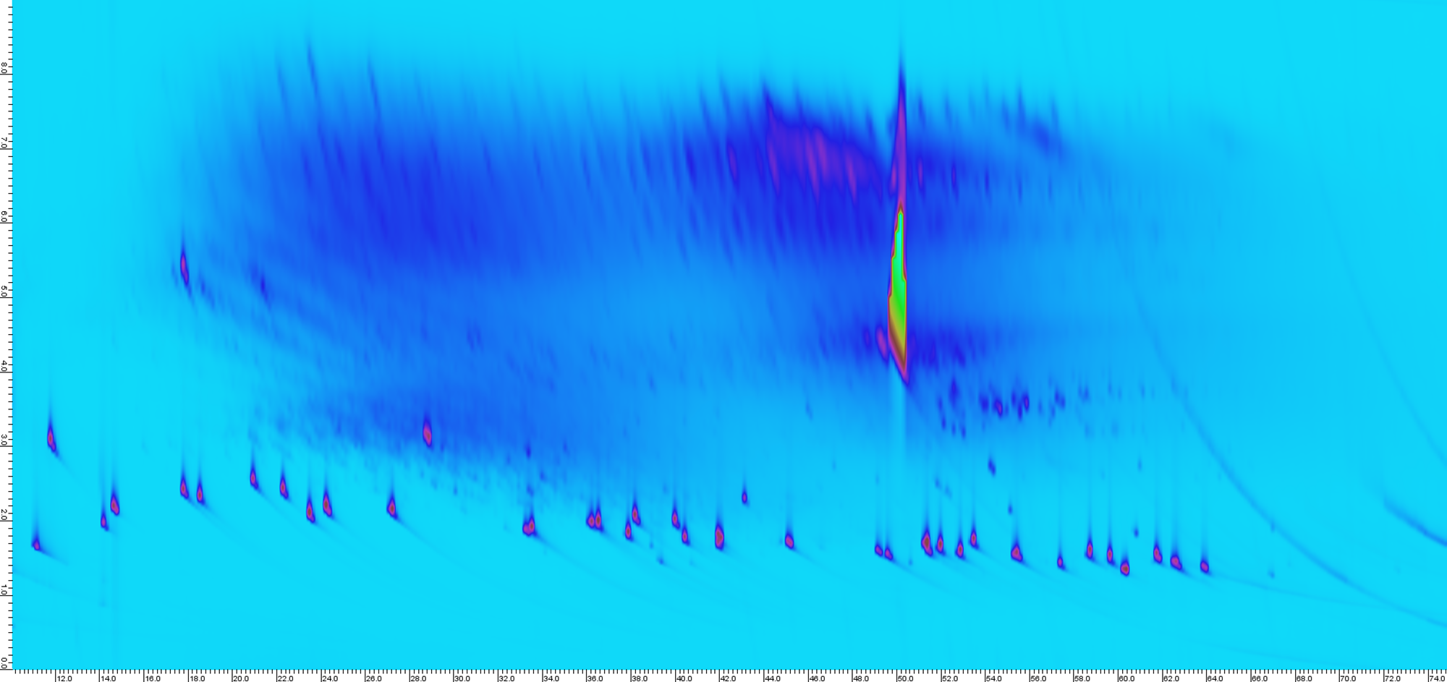
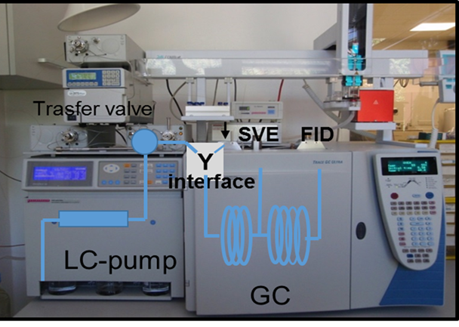
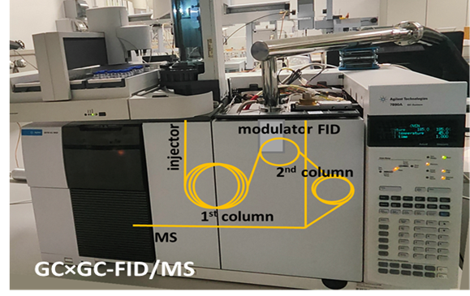
Analytical solutions for complex mixtures
Coupled chromatographic techniques to characterize mixtures of substances in food
Application to the analysis of saturated and aromatic hydrocarbons in oils
HPLC-GC-FID on-line
GC×GC-FID/MS

Slide 12
Sustainable processes for transformation of biomass, including fatty esters,
into high-value biological products

Slide 13
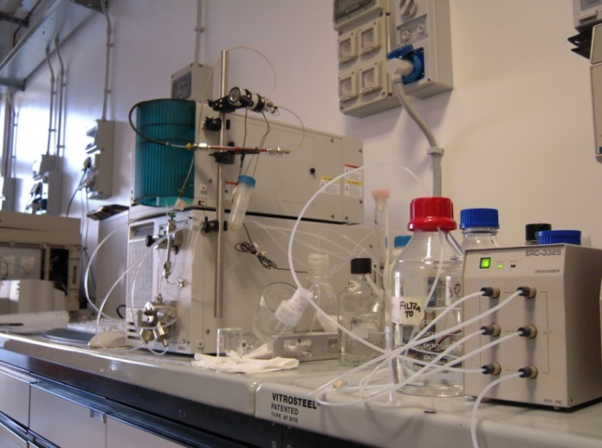
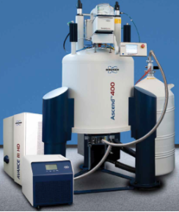
Instruments and facilities
bioreactors, freeze-dryer, digesters, systems for extraction with supercritical fluids
Southern/Northern blotting
HPLC-GC, GC-QPMS/ITD-MS, LC-LC
nuclear magnetic resonance (NMR)

Slide 14
Educational activities
Transversal courses
English language, mobility, research, communication, career development
2) Specific courses of the PhD in Food Science
- Experimental and modeling methodologies
- Food development through a food structure design approach
- Ethics of Research
- Evaluation of the nutritional characteristics of foods
- The omics sciences
3) Other events of the PhD in Food Science
Journal Club: critical presentation of an article
Data Club: presentation of the achieved results
National workshop: Developments in the Italian PhD research on food science, technology and biotechnology

Slide 15
Occupational placement of the PhDs
16 PhDs of the Course of “Food and Human Health” (last 3 years)
1 researcher (RTDA) (Bolzano)
7 research fellows (Padova and Udine universities, Ireland)
2 technicians in food control
1 employee in a Consortium (permanent contract)
4 employees in companies (1 with a permanent contract, 1 abroad)
1 unemployed

Slide 16
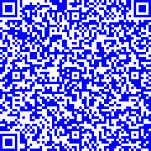

Testimonial :
Asja Brovedani
Testimonanza Donne nelle Stem:
Udine, 29 APRILE 2026
Direzione RICERCA, BIBLIOTECHE E TERZA MISSIONE

Slide 17
Coordinator: Prof. W. Baratta walter.baratta@uniud.it
Vice-coordinator: Prof.ssa M. Manzano marisa.manzano@uniud.it
Udine, 29 APRILE 2026
Direzione RICERCA, BIBLIOTECHE E TERZA MISSIONE

Slide 18

Il bando per l’ammissione al corso di dottorato è disponibile al sito:
Per ulteriori informazioni sulle procedure di ammissione contattare
Direzione ricerca, biblioteche e terza missione - Ufficio formazione per la ricerca
dottorato.rice@uniud.it
Udine, 29 APRILE 2026
Direzione RICERCA, BIBLIOTECHE E TERZA MISSIONE

