Slide 1
Open PhD 2026 Presentazione dottorati di ricerca a.a. 2026/27 Dottorato di ricerca in Scienze Matematiche e Fisiche
Udine, 29 APRILE 2026
Direzione RICERCA, BIBLIOTECHE E TERZA MISSIONE

Slide 2

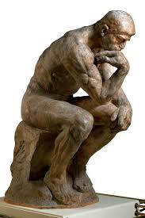
Why a PhD in Mathematics and Physics?
Exploit curiosity at a very high level You get to work on questions that don’t have known answers.
Not homework problems—actual unknowns.
If that excites you more than it intimidates you, that’s a strong signal you should do our PhD.
Learn HOW TO THINK, not just WHAT TO KNOW A good PhD trains you to:
break down vague problems
build models from scratch
handle failure repeatedly without losing direction

Slide 3

Why a PhD in Mathematics and Physics?
Gain access to research environments and resources
You’re paid (not too much, honestly) to:
attend conferences
collaborate with experts
contribute to new knowledge
The degree signals that you can:
solve hard, abstract problems
work independently for long periods
learn complex systems quickly
Those skills are valuable in several sectors.

Slide 4
Which career paths after our PhD ?
1. Academia
The »classic» route. Postoc-> Professor
Research+teaching
2. Data Science and AI
Data scientist
Machine learning engineer
AI researcher
(statistics, optimization, linear algebra, modeling)

Slide 5
Which career paths after our PhD ?
3. Quantitative finance
Quant analyst (“quant”)
Risk modeler
Algorithmic trader
(probability, stochastic processes, PDEs)
4. Tech industry
algorithms
cryptography
optimization
simulation

Slide 6
Which career paths after our PhD ?
5. Research labs (non academic)
Government labs
Private R&D (tech, energy,defence)
(for physics: Semiconductors, Photonics / optics, Materials science, Energy (fusion, renewables), Aerospace / defense
6. Consulting
Strategy consulting
Technical consulting
7. Teaching (non-university)
High school or specialized institutions

Slide 7
Research areas: Mathematics
Algebra
Hamiltonian
mechanics
Number
theory
Dynamical
systems
Topology
Mathematical
logic
Calculus of
variation
Numerical
analysis
Statistics
Operation
researchs
Math methods
of economy
Nonlinear
analysis
Control
theory

Slide 8
Research areas: Physics
Quantum
Gravity
Renewable
energies
Molecular
modelling
Astrophysics
Black Holes
physics
General
Relativity
Fundamental
interactions
Simulation of
bio&nano systems
Semi-conductor
based detectors

Slide 9
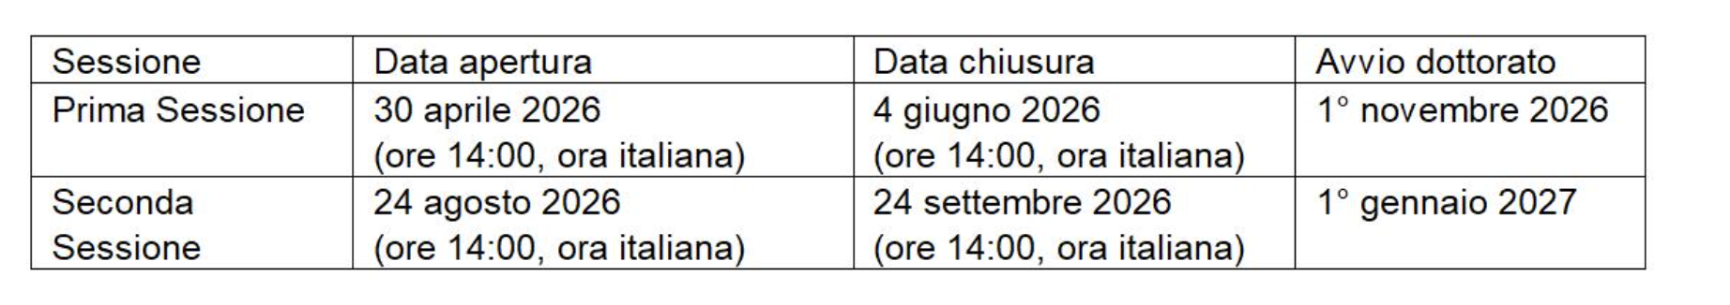
The PhD course
Started in 2020
XLII cycle
Courses:
https://dmif.uniud.it/it/didattica/dottorato/smf/offerta-didattica/phd-training-project

Slide 10
Supervisors: Mathematics
Giovanni Bellettini - Mathematical analysis
Dimitri Breda - Numerical analysis
Diego Cattaruzza - Operations research
Sara Ceschia - Operations research
Pietro Corvaja - Geometry
Pietro De Poi - Geometry
Vincenzo Dimonte - Mathematical logic
Guglielmo Feltrin - Mathematical analysis
Lorenzo Freddi - Mathematical analysis
Paolo Gidoni - Mathematical physics
Anna Giordano Bruno - Algebra
Aleks Jevnikar - Mathematical analysis
Mario Mainardis - Algebra
Alberto Marcone - Mathematical logic
Roberta Musina - Mathematical analysis
Dario Spirito - Algebra
Rodica Toader - Mathematical analysis
Stefano Urbinati - Geometry
Rossana Vermiglio - Numerical analysis

Slide 11
Supervisors: Statistics
Michela Battauz - Statistics
Gianni Bosi - Mathematical methods for economy, finance and actuarial sciences
Valentina Mameli - Statistics
Andrea Molent - Mathematical methods for economy, finance and actuarial sciences
Antonino Zanette - Mathematical methods for economy, finance and actuarial sciences

Slide 12
Supervisors: Physics
Stefano Ansoldi: Cosmology and Astrophysics
Marina Cobal: Particle Physics, Renewable Energies
Federico Fogolari: Molecular Modeling, Structural Biology, Biomolecular Simulations
Paolo Giannozzi: Struttura della materia, Nanotecnologie
Gilberto Giugliarelli: Semiconductor based Detectors Development
Alberto Gola: Development of silicon photodetectors, ionizing rad. Detectors
Simone Monzani: X-ray and High-Energy Astrophysics, Semiconductor based Detectors
Daniele Pranzetti: Cosmology

Slide 13
Workplan
1st year
Attend courses/schools, also organized by the University (transversal or thematics)
Begin research activity
End-of-the-year reporting, evaluation (learning activity & research plan)
2nd year
Conclude the learning activity
Research activity full immersion
Teaching
End-of-the-year reporting, evaluation (learning activity & research activity)

Slide 14
Workplan
3rd year
Conclude research and write PhD thesis
Teaching
Exhibition at the University (PhD Expo)
Admission to the final exam (external review of the PhD thesis)
Beginning of the new year: discussion of the thesis, graduation

Slide 15
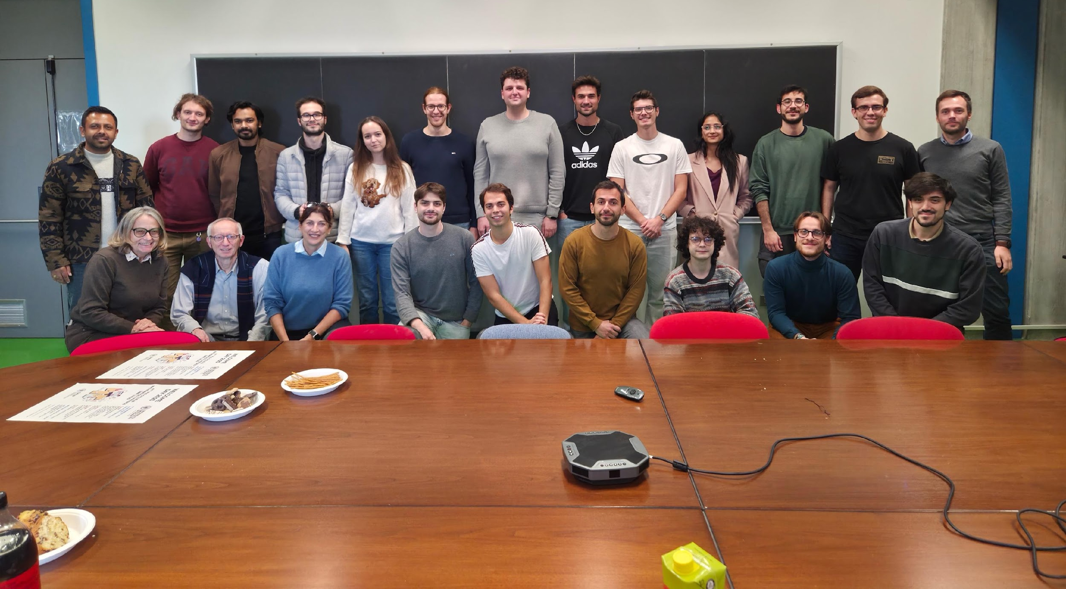
Marina Cobal: Marina.Cobal@uniud.it (physics) Guglielmo Feltrin: Guglielmo.Feltrin@uniud.it (math)
Udine, __ APRILE 2026
Direzione RICERCA, BIBLIOTECHE E TERZA MISSIONE

Slide 16
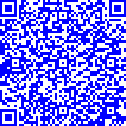
Il bando per l’ammissione al corso di dottorato è disponibile al sito:
Per ulteriori informazioni sulle procedure di ammissione contattare
Direzione ricerca, biblioteche e terza missione - Ufficio formazione per la ricerca
dottorato.rice@uniud.it
Udine, 29 APRILE 2026
Direzione RICERCA, BIBLIOTECHE E TERZA MISSIONE

